Slide 1
On tsunami attacks on the southern Italian coasts: from hazard to vulnerability and risk
S.Tinti, A.Armigliato, G.Pagnoni, R.Tonini
Università di Bologna, Italy
stefano.tinti@unibo.it
24th International Tsunami Symposium of the IUGG Tsunami Commission
Novosibirsk, 14-16 July, 2009

Slide 2
Tectonic Setting of the Mediterranean Basin
Tinti et al., 2005
Stefano Tinti

Slide 3
Seismicity in the NEAM region
Tinti et al., 2005
Stefano Tinti

Slide 4
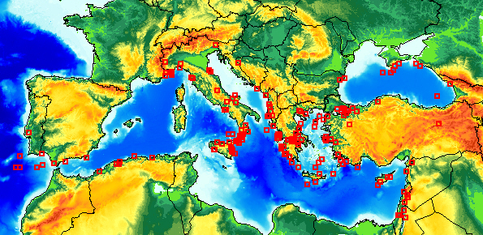
Tsunamis in the Euro-Mediterranean Region
Stefano Tinti

Slide 5

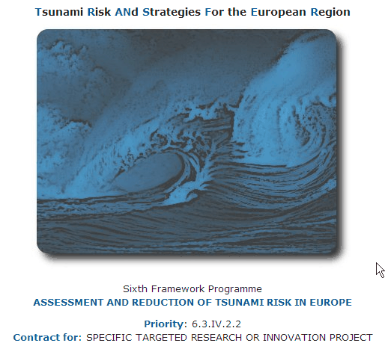

Coordinator: Stefano Tinti
University of Bologna, Italy
stefano.tinti@unibo.it
http://www.transferproject.eu

Slide 6

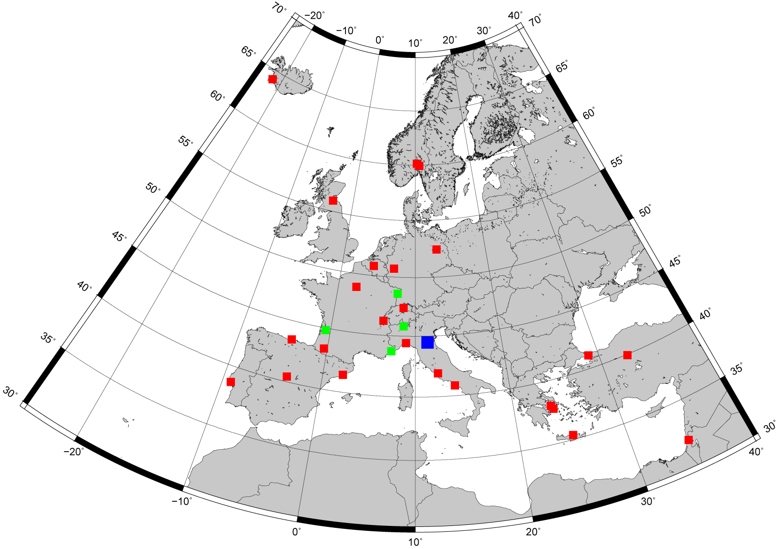
EC Project TRANSFER: Tsunami Risk ANd Strategies For the European Region
TRANSFER Partners
IMOR
ICG
NMA
NERC
EC
GFZ
CNRS
UNU
CEA
USTR
UBOR
ETHZ
WAPMERR
JRC
DFUNIBO
KOERI
UCA
UPPA
GEOAZUR
DAPP
INGV
METU
CGUL
OPPE
UB
URoma
UI
IGN
AMRA
NOAGI
HCMR
FORTH
GII

Slide 7
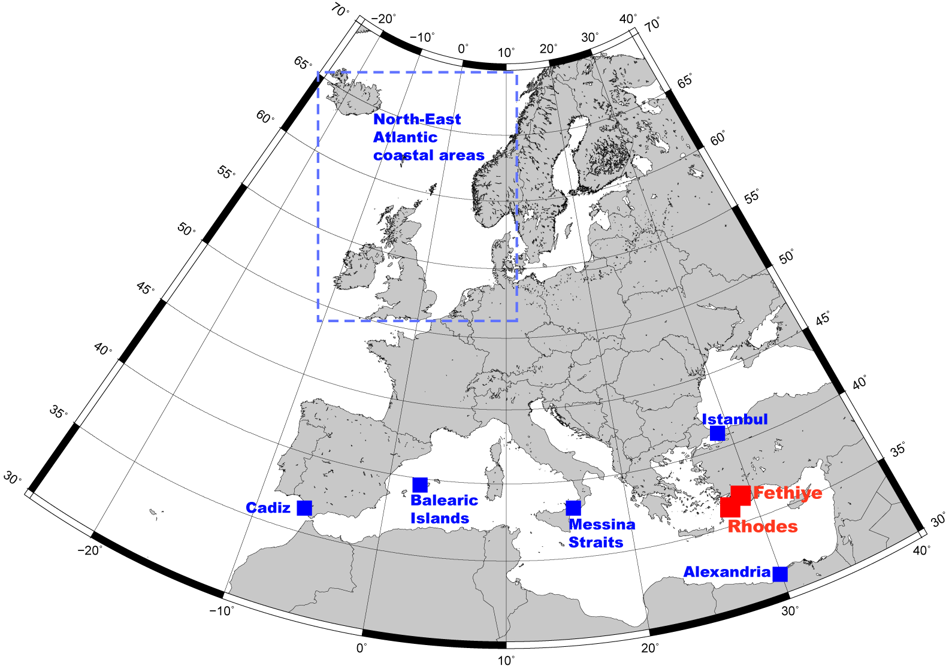
EC Project TRANSFER: Tsunami Risk ANd Strategies For the European Region
TRANSFER Test Sites
Black Sea

Slide 8
Terminology
Danger
A (natural) phenomenon that could lead to a damage,
described in terms of physical and process properties
(its geometry, its dynamics…)
The danger can be an “actual” existing one, such as a creeping slope, or a “potential” one, such a future earthquake or a tsunami
Hazard
Probability that a given danger occurs within a given period of time and in a given region
Stefano Tinti

Slide 9
Terminology
Danger
A (natural) phenomenon that could lead to a damage,
described in terms of physical and process properties
(its geometry, its dynamics…)
The danger can be an “actual” existing one, such as a creeping slope, or a “potential” one, such a future earthquake or a tsunami
Hazard
For example: annual probability of a significant tsunami
Stefano Tinti

Slide 10
Terminology
Risk
Measure of the probability and severity of an adverse effect to life, health, property, environment…
(risk could be real or perceived)
RISK= HAZARD x CONSEQUENCE
RISK=HAZARD x POTENTIAL WORTH OF LOSS
RISK=HAZARD x VULNERABILITY x WORTH OF LOSS
Stefano Tinti

Slide 11
Example of hazard analysis
for eastern Sicily and
southern Calabria, Italy
Hybrid Method
Local Tsunamis
Stefano Tinti

Slide 12
INGV +CPTI2 Seismic Catalogue: 476 BC -2006
Magnitude
Stefano Tinti

Slide 13
Focal parameters +
Earth Surface Displacements
vs. Moment Magnitude
Wells and Coppersmith: Bull.Seism.Soc.Am., 1994
Hanks and Kanamori:
J.Geophys.Res., 1979
Okada:
Bull.Seism.Soc.Am., 1992
Stefano Tinti

Slide 14
Magnitude
Magnitudes that produce coastal tsunami heights larger than 1 m
Stefano Tinti

Slide 15
INGV + CPTI2
Synolakis amplification law
N_{TOT}= 88.8
Ward amplification law
Number of expected tsunamis in 10,000 years producing coastal tsunami heights larger than 1 m
Stefano Tinti
N_{TOT}= 112

Slide 16
Example of a risk analysis for eastern Sicily and southern Calabria
applied to the population
Local Tsunamis
Stefano Tinti

Slide 17
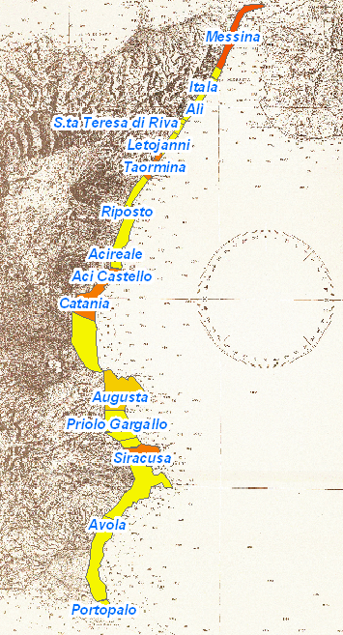
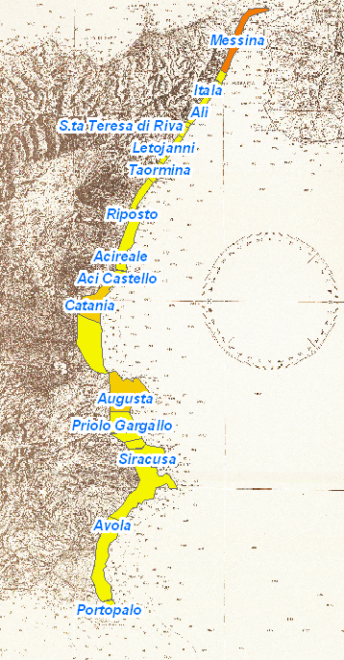
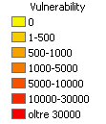
Eastern Sicily – Involved Population
“Small tsunami”-Probability: ∼ 5 10⁻³
Summer: 34,000
Stefano Tinti
Winter: 3000

Slide 18
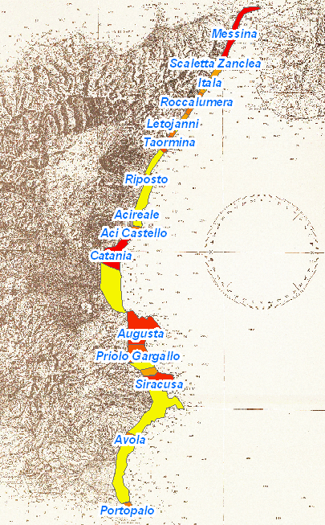
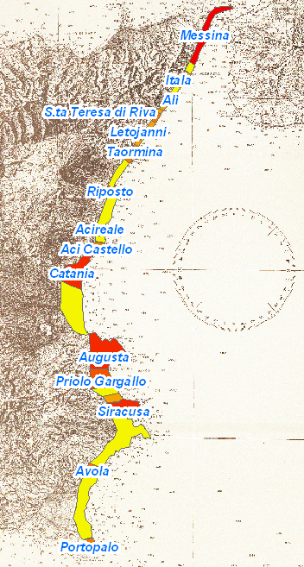
Eastern Sicily – Involved Population
“Big tsunami”- Probability: ∼ 1 10⁻³
Summer: 191,000
Winter: 163,000
Stefano Tinti

Slide 19
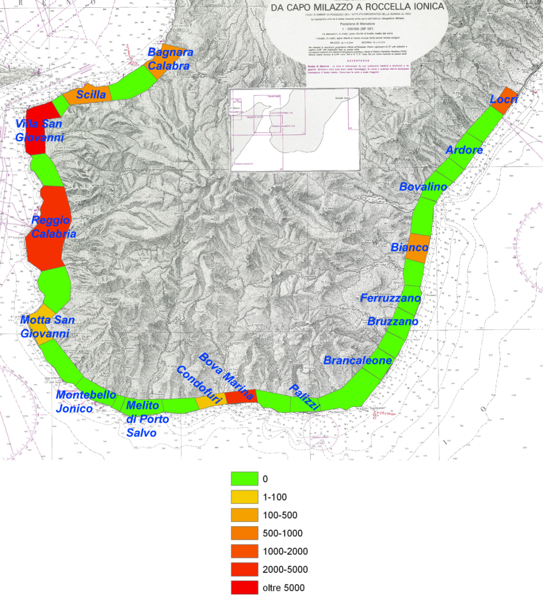
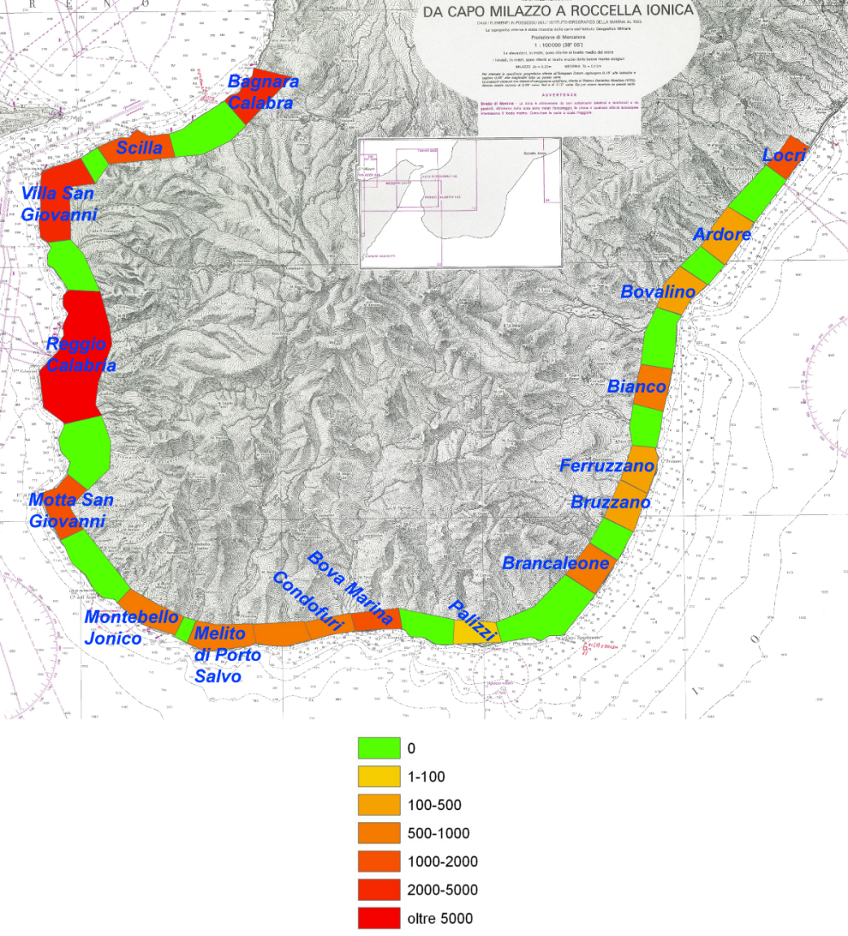
Southern Calabria – Involved Population
“Small tsunami”
Probability: ∼ 5 10⁻³
“Big tsunami”
Probability: : ∼ 1 10⁻³
Summer 6000 Winter: 400
Summer 26,000 Winter: 24,000
Stefano Tinti

Slide 20
The worst case scenario
for remote sources
Stefano Tinti

Slide 21
Possible Scenarios of Basin-wide Tsunamis
Stefano Tinti

Slide 22
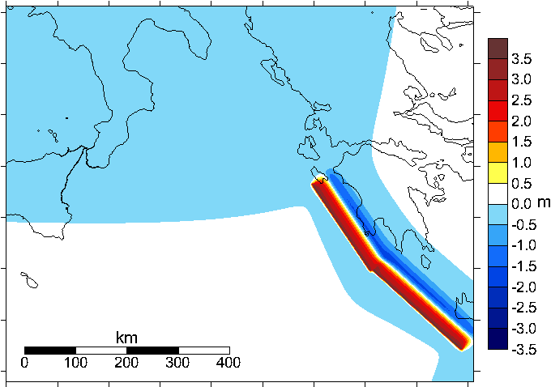
Tsunami Induced by a Western Hellenic Arc source
Fault parameters (Mw = 8.3):
Northern Segment
Length = 206 km
Width = 38 km
Strike = 326°
Dip = 20°
Rake = 90°
Slip = 10 m
Depth = 1 km
Co-seismic Earth -Surface Vertical Displacement
Southern Segment
Length = 233 km
Width = 38 km
Strike = 312°
Dip = 20°
Rake = 90°
Slip = 10 m
Depth = 1 km
Simulations performed with the tsunami code UBO-TSUFD developed and maintained by the Tsunami Research Team of the University of Bologna.
Roberto Tonini

Slide 23
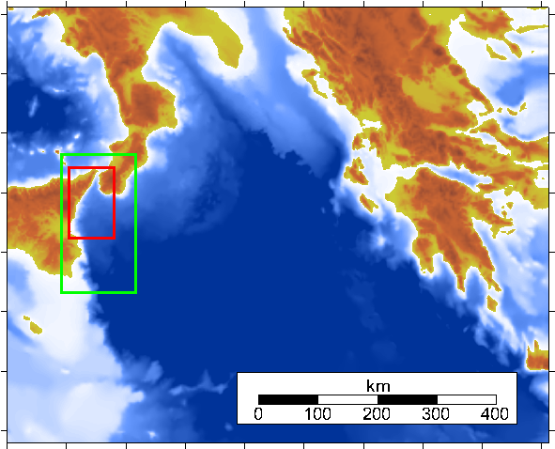
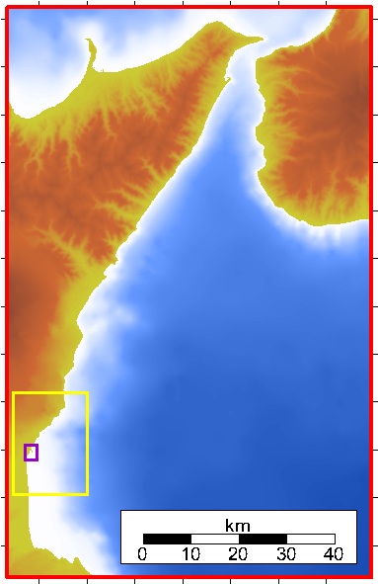
Computational Grids
Grid 1
Grid 3
Grid 3
Grid 2
Grid 4
Grid 5
Grid 1 step = 3000 m
Grid 2 step = 1000 m
Grid 3 step = 200 m
Grid 4 step = 40 m
Grid 5 step = 8 m
Roberto Tonini

Slide 24
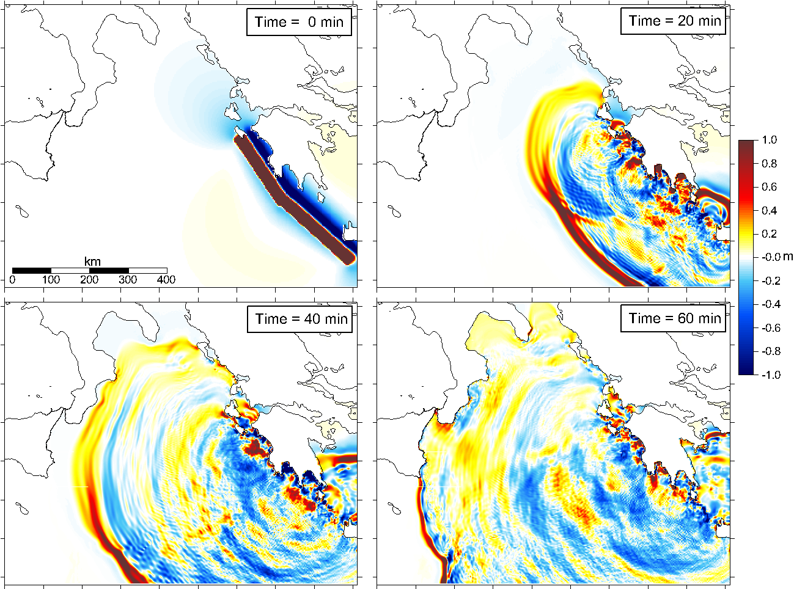
Snapshots of Tsunami Elevation Fields
Roberto Tonini

Slide 25
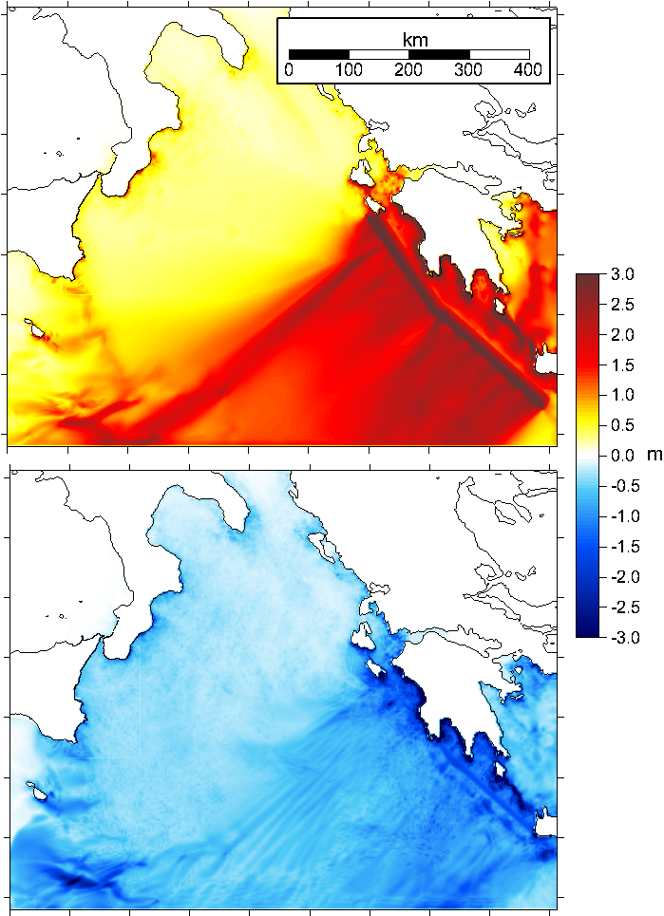
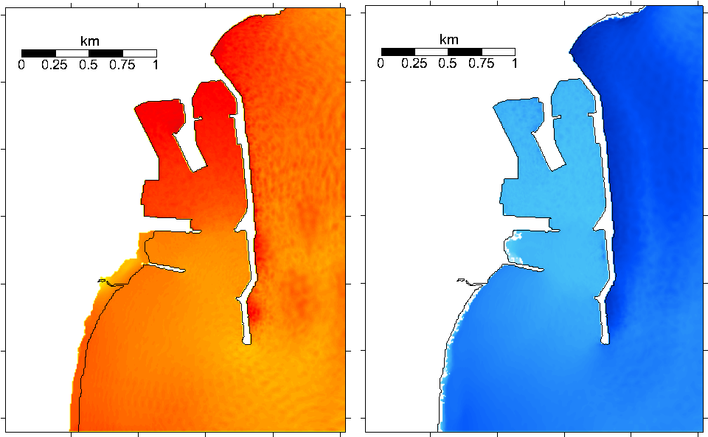
Maximum and minimum elevation fields
in 2 hours simulation time
Grid 5: Catania Harbour
Roberto Tonini

Slide 26
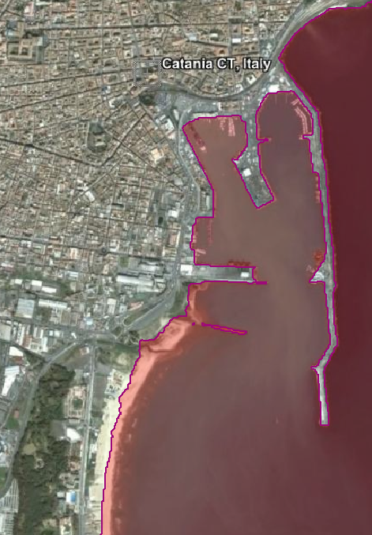
Flooding Map
for the Catania harbour zone
Roberto Tonini

Slide 27
Example of a preliminary vulnerability and risk analysis applied to buildings in Catania
Project SCHEMA
Stefano Tinti

Slide 28
SCHEMA Table of Building Types
Class | Building types | Height and storeys | detection on space imagery (visual recognition on optical images). | Other criteria for local context | Class correspondence with other work
A | Wooden, timber, Beach or sae front light constructions | Individual, 1 storey, Rarely 2 storeys for beach constructions | Flats roof, steel sheets Small to very small surfaces Extended surfaces in case of beach activities (restaurants, clubs) | Flat roof Isolated of close to each other, on beaches or coast berms, can have parking behind | Class A Leone 2006
B | Brick not reinforced, cement mortar walls, Fieldstone, masonry | 1 or 2 storeys | Flat or slope roofs, steel roofs, No chimneys in general Little extension or surface | Small garden in front or around | Class B Leone 2006
C1 | Brick with reinforced column and masonry filling, in general individual buildings, villas | 1 or 2 storeys | Tiles or slates, flat roof Rectangular or square or more complex but small surface |  | Class C Leone 2006
C2 | Old industrial and residential buildings, walls made of lava blocks alternating with clay bricks | 1 to 3 storeys Collective building | Not possible | Garden and swimming pools | Class C Leone 2006
D1 | Residential or commercial building concrete not reinforced, large villas or collective building | 1 to 3 storeys Collective building | Flat roofs Tiles with slope roof Balcony or terraces visible Large extension |  | Class D Leone 2006
E1 | Building in RC Residential or collective structures or offices, parking, schools | 3 storeys | Flat roof or slope roof Chimneys Air conditioning equipment visible | Sidewalk and parking along buildings | Class E Leone 2006
E2 | Building in RC Residential or collective structures or offices, parkings, schools, towers | More than 3 stories | Generally flat roof with equipment on top (air conditioning, water, etc). Chimneys Terraces or balconies visible
G | Harbour and Industrial building, reinforced concrete, steel frames, hangar | undifferentiated | Steel sheets Flat roofs with multiple equipment Large roof windows
H | Other, historical buildings Administrative buildings | Undifferentiated | Domes or towers visible

Slide 29
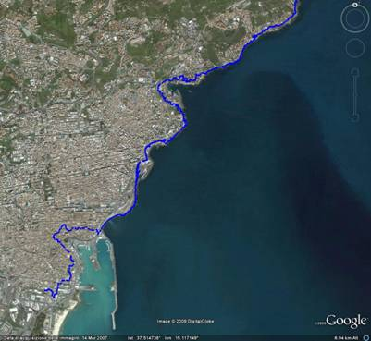
Vulnerability Analysis
2
1
For the preliminary vulnerabilty analysis in the town of Catania we selected zones below the 10 m isoline (blu line)
Stefano Tinti

Slide 30
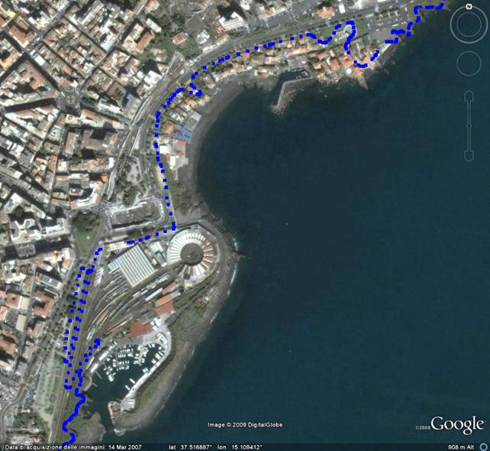
Zone 1
Marina
“San Giovanni Licuti”
Touristic beach
Depot train
Marina “Porto Rossi”
Stefano Tinti

Slide 31
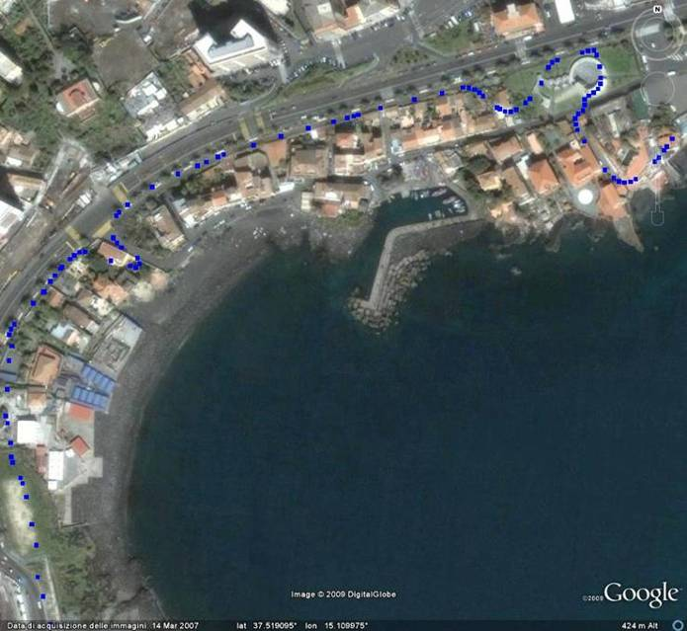
Zone 1 north
From the picture we count about 40 buildings.
The most probable class is B and for some few buidings A
Stefano Tinti

Slide 32
SCHEMA Damage Matrix
as a function of the flow depth
Damage level |  | Class A | Class B | Class C | Class D | Class E₁
No damage | D₀ | 0 | 0 | 0 | 0 | 0
Light damage | D₁ | 0 – 1.8 | 0 – 2 | 0 – 2.5 | 0 – 2 | 0 – 3
Important damage | D₂ | 1.8 – 2.2 | 2 – 3 | 2.5 – 4 | 2 – 4.5 | 3 – 6
Heavy damage | D₃ | 2.2 – 2.6 | 3 – 4 | 4 – 6 | 4.5 – 6.5 | 6 – 9.5
Partial collapse | D₄ | 2.6 – 3.8 | 4 – 5 | 6 – 8 | 6.5 – 9 | 9.5– 12.5
Total collapse | D₅ | > 3.8 | > 5 | > 8 | > 9 | > 12.5
flow depth in m
Stefano Tinti

Slide 33
The End
S.Tinti, A.Armigliato, G.Pagnoni, R.Tonini
Università di Bologna, Italy
stefano.tinti@unibo.it
24th International Tsunami Symposium of the IUGG Tsunami Commission
Novosibirsk, 14-16 July, 2009

